Slide 1

Presenters: Atul Aneja, Divya Kamath and Syed Sirajuddin AAI 501 Capstone Project (April 11th, 2025) Video Link: https://www.youtube.com/watch?v=VM9JW4AUZws&ab_channel=AtulAneja GitHub Link: https://github.com/AtulAneja/AAI501FinalProject
Artificial Intelligence and Machine Learning Techniques to Analyze Trade and Tariff impacts on the Economic Outcomes

Slide 2
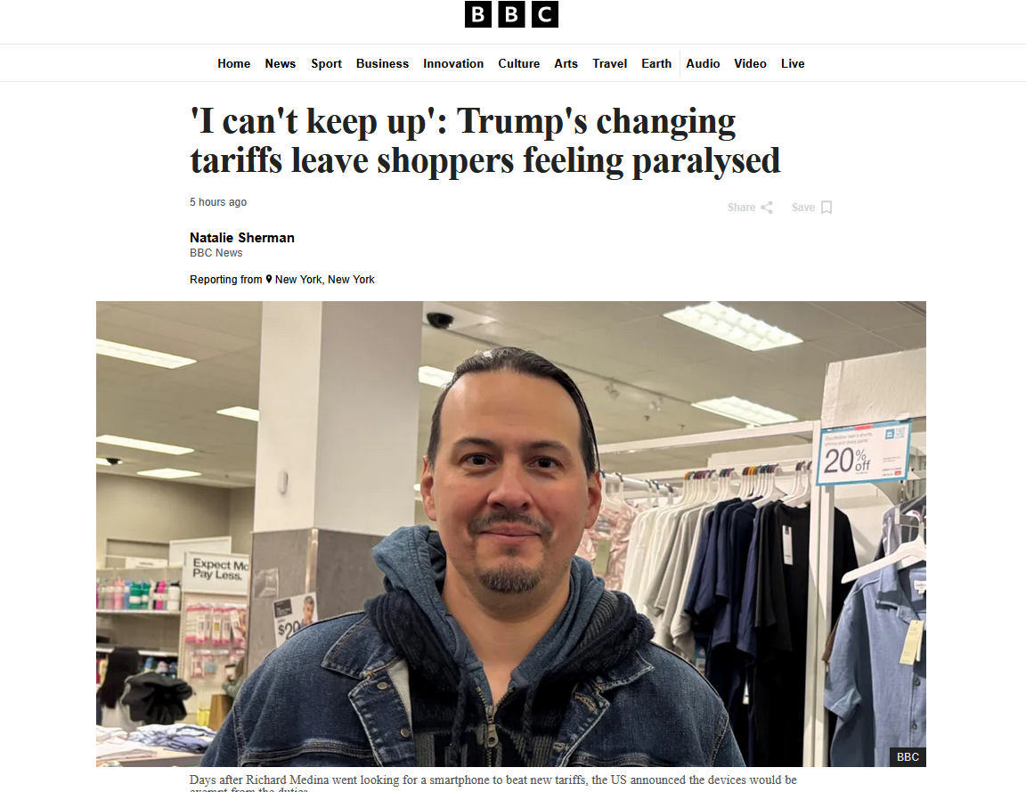
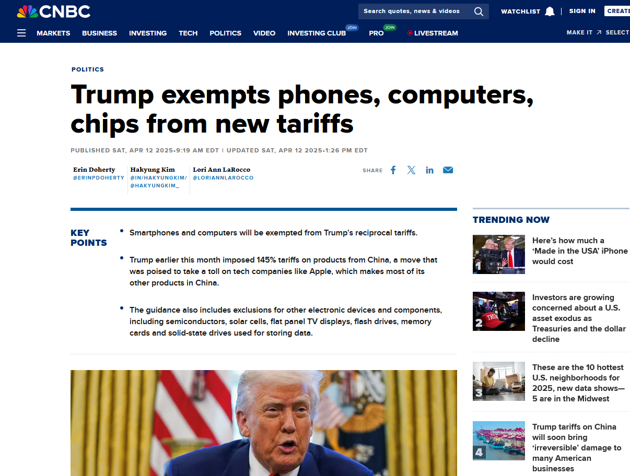
Objective
Use AI/ML to analyze International Trade and its effect on GDP
Real world example where AI and ML could be used in a non-trivial way.
HUGE business case
Applicable to recent news
Complex relationships between various factors and the interplay between them.

Slide 3
Machine Learning Models and Techniques
Supervised Learning using Classification
Support Vector Machine
Decision Tree
Supervised Learning using Regression
Random Forest
Gradient Boost (Catboost)
Recurrent Neural Network (RNN)
LSTM (Long Short-Term Memory)

Slide 4
Datasets and their Sources
Annual reporting of data ranging between 1990 – 2024
Dataset sources
Import/Export Data
Gross Domestic Product (GDP)
Population
Consumer Price Index (CPI)
Tariff Rate (AHS Weighted Average Tariff)
Also known as Effectively Applied Weighted Average Tariff
U.S. Census Bureau
United States International Trade Commission’s "Trade Shifts" report
World Bank
Kaggle

Slide 5
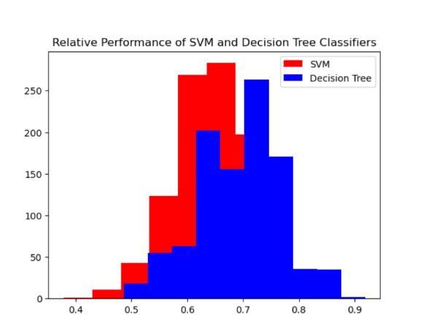
Supervised Learning using Classification

Slide 6
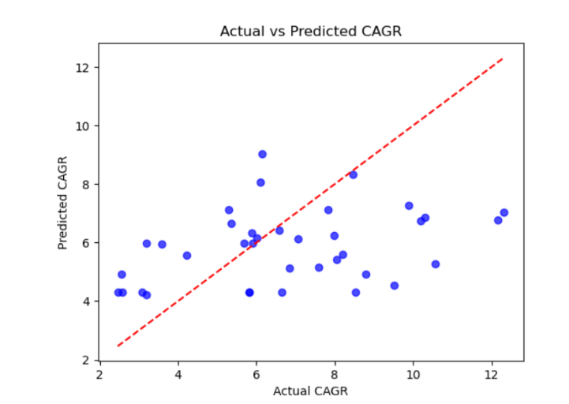
Supervised Learning Using Regression

Slide 7
Gradient Boost Regression Model
Gradient Boosting Regression- Ensemble learning method that combines multiple weak regression models using decision trees to create a strong predictive model. It works by sequentially building models, with each new model focusing on correcting the errors of the previous ones, and ultimately combining and improving them iteratively to make a better prediction model.

Slide 8
Gradient Boosting Decision Trees (GBDT) Key Concepts
Ensemble Learning Model: Combines multiple models to improve performance.
Decision Tree: A machine learning model that makes “decisions” by splitting data into branches based on features until it reaches a prediction.
Boosting: Sequentially build models that correct prior errors
Gradient Boosting: Uses gradient descent to correct errors

Slide 9
Features/Indicators
Years (2000 – 2023)
CPI – Consumer price Index
Imports (in USD)
Exports (in USD)
AHS Weighted Average Tariff Rate
GDP – Gross Domestic Product

Slide 10
Catboost Libraries
Native support for categorical boosting
Handles missing values without requiring imputation
Learns target-based statistics without overfitting
Supports regression, classification, ranking, and time-series forecasting
Similar libraries:
XGBoost
LightGBM

Slide 11
Catboost hyperparameters
Parameter | Meaning | Value Used | Effect
iterations | Total number of boosting rounds | 500 | More trees → better accuracy (to a point)
learning_rate | Shrinkage factor for each tree | 0.05 | Smaller → slower but safer learning
depth | Max depth of each decision tree | 6 | Controls tree complexity
loss_function | Error metric to minimize | 'RMSE' | penalizes large errors more
verbose | Print training progress every n steps | 100 | Helps you monitor training

Slide 12
Important Note on CatBoost and Lag Features
CatBoost supports time series forecasting, but not natively. Some tweaking by the user must be done in order for it to work
It is not sequence aware unlike a LMST
The solve this issue, lag features must be introduced to turn the time series problem into a supervised learning problem.
What are lag features:
Previous values of a variable are used as predictors
i.e. GDP_lag_1 = GDP @ t=1
Allows CatBoost to "see the past" and learn trends
They capture temporal dependencies such as momentum, seasonality, and volatility.

Slide 13
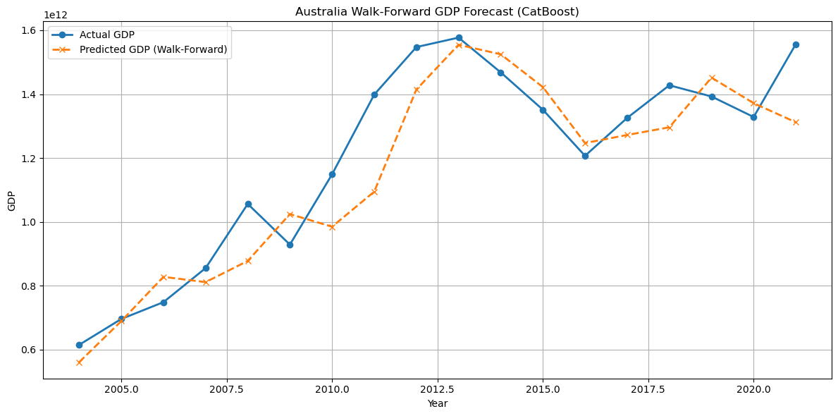
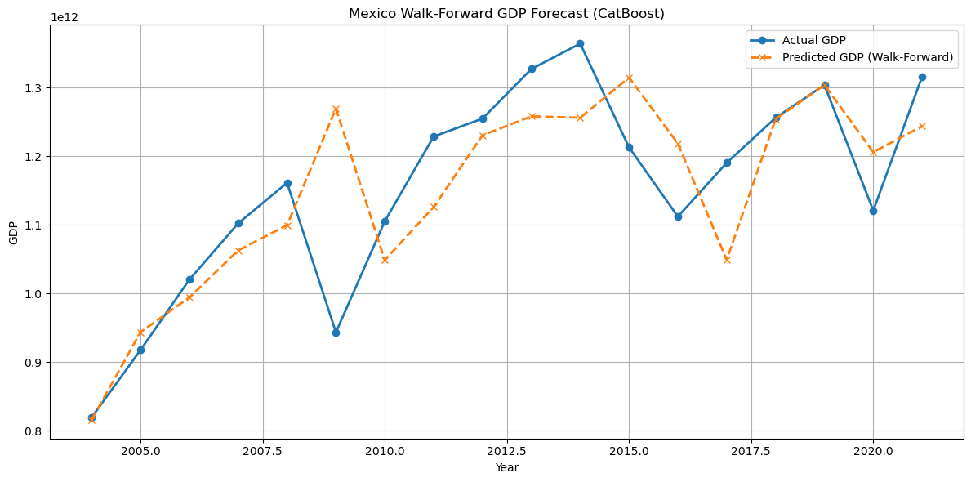
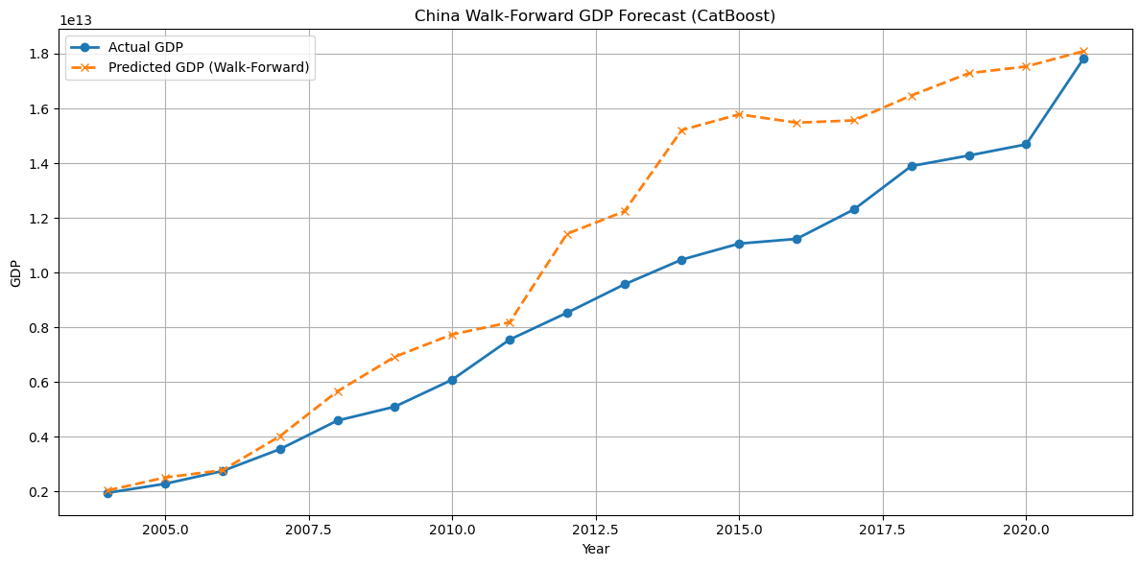
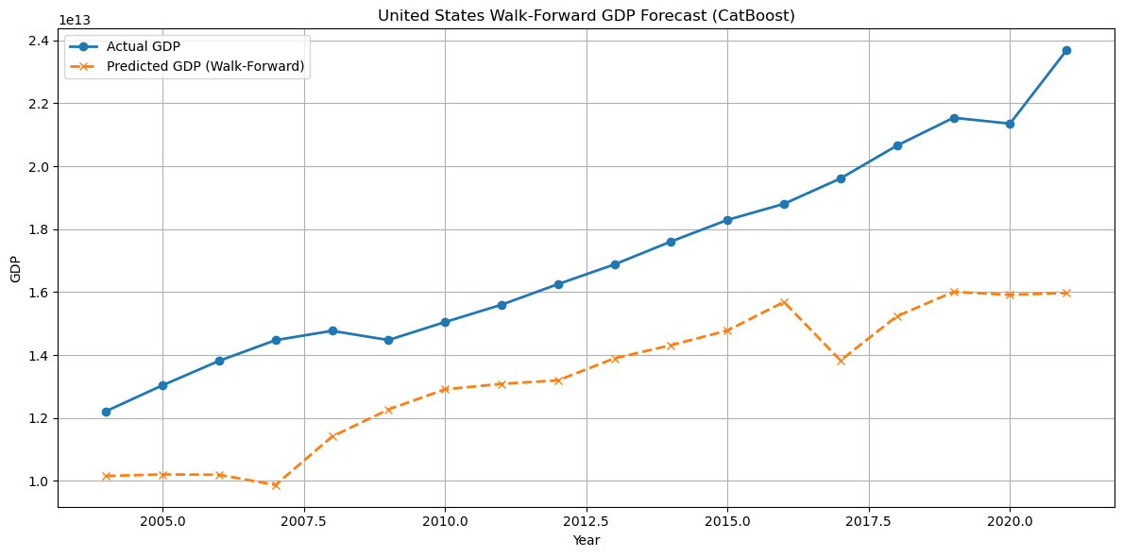
Visualization of Data Predictions by Country

Slide 14
Catboost Regression Evaluation Metrics
MAE on test set: $76.2 billion
Mean absolute error – average absolute difference between actual and predicted values
Due to wide range of values for GDP between countries, our model works best for countries with high GDP. Countries with lower GDP, especially if it’s less than $80 billion USD should use a more specific features that can give a more accurate analysis.
R² Score: 0.9791
Amount of variance in the prediction target explained by the model. Values close to 1 signifies that the model closely explains the variance.

Slide 15
Impact of Wide Value Ranges: How to Improve Accuracy
Issues:
GDP values span from billions to trillions
Export/import values differ dramatically between countries
High-value data dominates model behavior countries
Recommendations
Scale features per country
Apply log transformations
Segment by GDP tier
Engineer relative features
Use custom loss weighting

Slide 16
Deeper Look
Apply feature normalization, scaling or log transformations on certain features and/or the target
Prevents large economies (i.e. US or China), from skewing model behavior
Segmented Modeling
Train separate models for different GDP tiers (e.g., high-income vs low-income countries).
We can use the classification model Divya talked about above to determine this
Additional Feature Engineering
Add a “GDP category” feature to allow the model to differentiate behavior by economic scale.
Change Trade as a % of GDP, or factor for GDP growth instead of absolute GDP size.

Slide 17
What are LSTMs
A type of Recurrent Neural Network (RNN) specifically designed to learn from sequential data, such as time series, text, or speech.
Traditional RNNs struggle with the vanishing gradient problem, making it hard to learn long-range dependencies. LSTMs solve this by using a special architecture that lets them remember information over long periods more effectively.

Slide 18
LSTMs are ideal for:
Time series forecasting (e.g., stock prices, weather, GDP) ← Our use case
Natural Language Processing (NLP) (e.g., language modeling, translation)
Speech recognition
Video classification

Slide 19

LSTM-Based Trade Forecasting
This section covers LSTM models to analyze and forecast trade data while incorporating tariff impacts to simulate real-world economic changes.

Slide 20
Problem Statement
Forecast global trade behavior under evolving tariff scenarios.
- Traditional models often fail to capture time-dependent patterns.
- Goal: Predict future imports and exports incorporating both historical and policy-driven data shifts.

Slide 21
Data Sources & Features
Imports & Exports (USD) by country/year
Tariff Rates (AHS Weighted Avg)
GDP and CPI (Consumer Price Index)
Time Frame: 2000–2023
Scaled using Min-Max Normalization
Source: World Bank, Kaggle, U.S. Census

Slide 22
Why use LSTM
Traditional regression can't model time dependencies.
LSTM captures long-range effects (e.g., post-tariff shifts).
Effective in time series tasks with external shocks.
Helps uncover hidden patterns over time.

Slide 23
LSTM Model Description
Implemented using Keras (TensorFlow backend)
Inputs: sequence of trade features over time
Outputs: multi-year forecasts of imports & exports
Loss Function: MSE (Mean Squared Error)
Forecast Horizon: 5 years
Validated on unseen countries

Slide 24
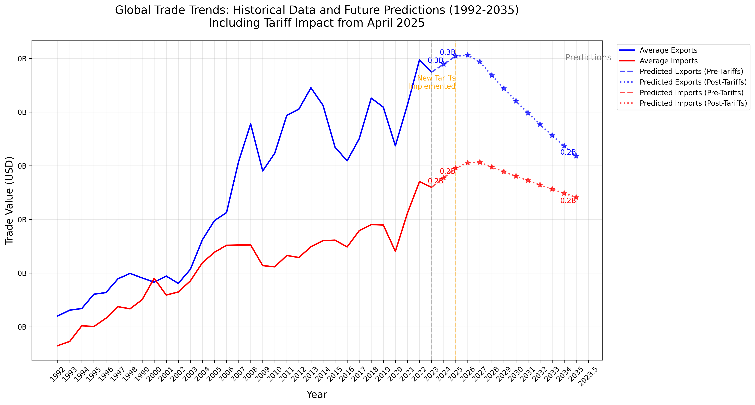
Trade Forecast Visualization

Slide 25
Forecast Interpretation
Model shows projected growth in exports post-COVID for multiple nations
Countries with reduced tariffs showed stronger recovery patterns
LSTM’s sensitivity helped capture delayed impact of economic shocks
Insights can assist policymakers in tariff adjustments

Slide 26
Summary and Learnings
Built LSTM to model time-based trade dynamics
Integrated policy features like tariffs into forecasting
Provided economic insights through AI-driven simulations
Reinforced importance of sequential learning models in macroeconomic analysis

Slide 27
Catboost vs LSTM (Comparison)
Which Model results in a more accurate prediction using the same features?

Slide 28
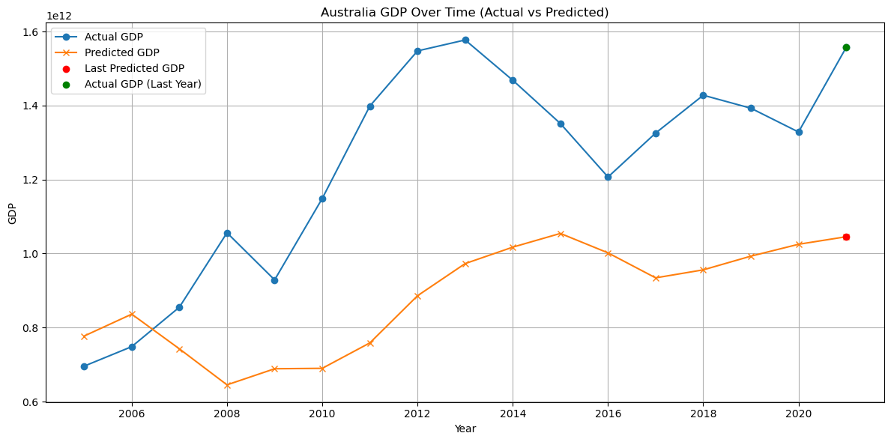
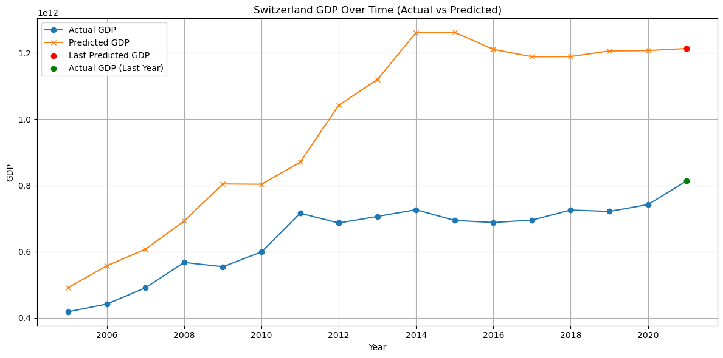
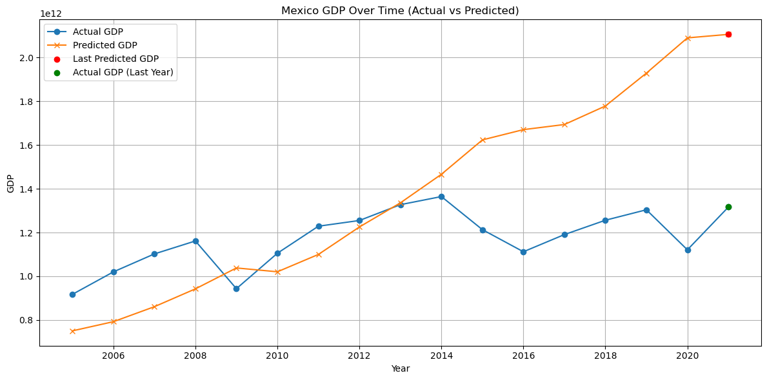
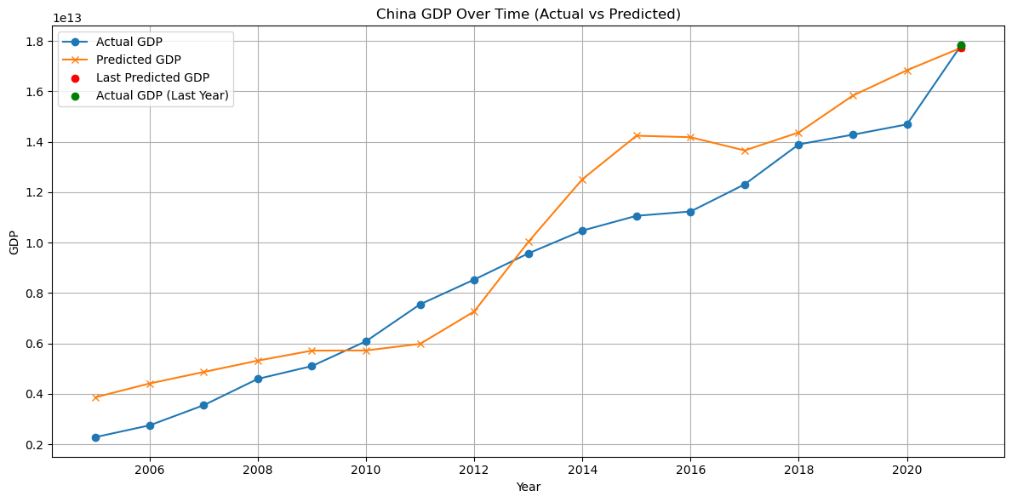
LSTM Comparison Overview

Slide 29
Evaluation Metrics
Catboost
LSTM Neural Nework
MAE: $76.2 billion
R² Score: 0.9791
MAE: $71.4 billion
R² Score: 0.9731

